Slide 1
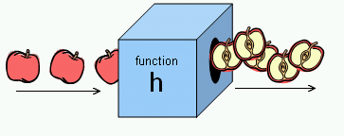
Web Programming
Objects, Functions & Conditionals

Slide 2
summary
Overview
Introduction to HTML
Tags, attributes, class/ID selector, CSS etc.
Introduction to JS
Input/output: prompt(…), alert(…);
Variable var & data types
– Variables：arithmetic operators: +
- * / % (modulo)
Conversion (strings -> numbers): Number(…); parseInt(...)
Math object: Math.sqrt(...), round(...), ceil(...), floor(...),
max(...,...), min(...,...), PI

Slide 3
Contents
Object, Function & expression
Conditionals & Relation
Number systems

Slide 4
Functions and why?
identifier(parameter1, parameter2, …)
Function performs a specific task or procedure.
The task is to be carried out at multiple places for
multiple times
The task (procedure) is defined by experts and can be used by multiple people
Modularity: modular programming

Slide 5
Q&A: Object-oriented Programming (OOP)
Uses classes and objects to create models based
on the real world environment.
Easy to maintain and modify existing code as new objects are created inheriting characteristics from existing ones
Easy to understand the program after development with well designed classes, objects and their methods and properties.
Efficiency: add new or destroy unused objects/ classes easily

Slide 6
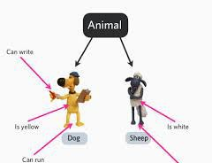
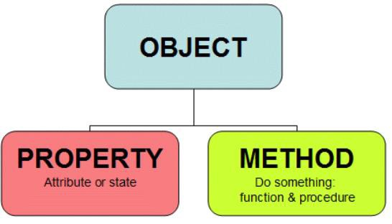
Q&A: Class/Object & JS
Class: a convenient way to abstract sets of objects with
common properties
"object" refers to a particular instance of a class
“object” can be containers of functions (methods), properties
(constants).
JS supports objects even without classes (OOP type)

Slide 7
Q&A: Procedure programming vs OOP
Procedure programming
Solving a problem from top of the code down to the
bottom
Statements start with strong verb
startCoffeeMachine(coffeemachineA);
washCoffeeMachine(coffeemachineB);
OOP
Solving a problem through objects
Statements start with the object to be manipulated
coffeemachineA.start(); coffeemachineB.wash();

Slide 8

Math.function( )
“Math” object: Container of math functions &
constants.
•Math.abs(x)
•Math.sqrt(x)
•Math.exp(x) : E^{x}
•Math.pow(x,n):
x to the power n
•Math.round(x), Math.ceil(x), Math.floor(x)
•Math.max(...,...), Max.min(...,...)
•Math.random() // [0,1)
1.7 the Math object
Math object [ref.]

Slide 9
Math.constant
Math.PI
returns PI, 3.14….
Math.SQRT2
returns 1.414…the square root of 2
Math.E
returns Euler's number 2.718…
It is just a value, so no brackets are needed.

Slide 10
Expression
A legal combination of :
Value(s)
Variable(s)
Function call(s)
Operators
An expression represents a value
Used in a statement where a value is
expected

Slide 11
Which is not an expression?
x 42
“I’m a string:-)” prompt(“enter you age:”) x * 42
x * 42 + “I’m a string :-)”
x * 42 + prompt(“enter you age:”)

Slide 12
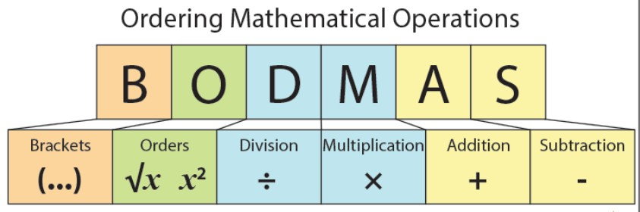
Evaluation sequencing
Nested functions: inner functions/brackets first
Follows the precedence of the operators BODMAS.
Use () when not sure

Slide 13
Try out : how does it work ?
If we enter 5:
alert(3+2+prompt(“Enter a number"));
alert(3+(2+prompt(" Enter a number"))); alert(3+Number(2+prompt(" Enter a number")));
Enter 5: 55
Enter 5: 325
Enter 5: 28

Slide 14
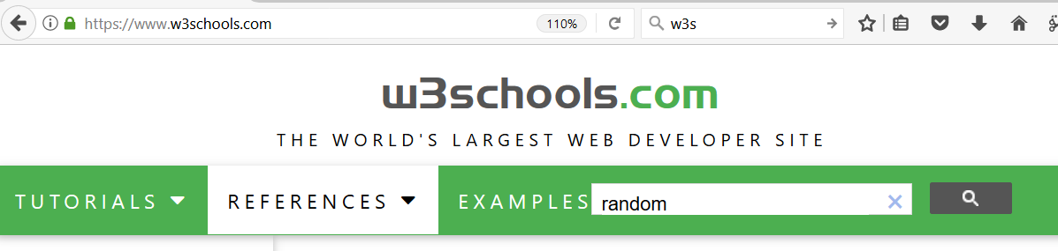
Try out:
Generate 8 random numbers between 0-10.
for(i=1; i<=8; i++) alert(Math.round(10*Math.random()));

Slide 15
Conditions

Slide 16


Conditions: if (…) …;
Decisive Programs: Branching / Selection
Begin Statement
if ( )
if true - Statement
End Statement

Slide 17
Conditions: if (…) … else …;
Decisive Programs: Branching / Selection
Begin Statement
if ( )
else
if true - Statement
if false - Statement
End Statement

Slide 18

if (…) … ; else …;
if ( test ) do-this-statement;
if(x >0 ) alert(“a positive number.”);
Alternatives:
if( test ) do-this-statement;
else do-the-other-statement; var x=15;
if (x>0)
alert(“a positive number.”);
else
alert(“it is <=0”);

Slide 19
Relational operators
Finding relationships between values:
what is the opposite operator to “x<0” ?
== equal
!= unequal
< less than
<= less than or equal
> greater than
>= greater than or equal
2.3 - relational operators

Slide 20
Try out: Relational operators
== equal
=== strict equal
!= unequal
!== strict unequal
< less than
<= less than or equal
> greater than
>= greater than or equal
Compare numbers, characters, or
strings
ASCII (American Standard Code for Information Interchange) here
var x = 2; alert(x==2); alert(x>=0); alert(x!=2);
alert('abc' == 'abc');
alert('abd' >= 'abc');
alert('aba' >= 'abc');
alert('abc' > 'ab');
alert(3 > 'abc');
var x = 'a';
alert(x=='a');
alert(x>='b');
alert(x!='p');

Slide 21
Is a letter before or after “a” in Ascii?
var c=prompt("enter a letter:");
if(c<'a')
alert(c+" is before 'a' in Ascii");
else
alert(c+" is after 'a' in Ascii");
Ascii table: space … 0-9 …. A-Z
… a-z

Slide 22
Anything wrong ?
var name=prompt("enter your name: ");
if(name="Mike")
alert("Hi Mike" );
else
alert("it is not Mike");

Slide 23
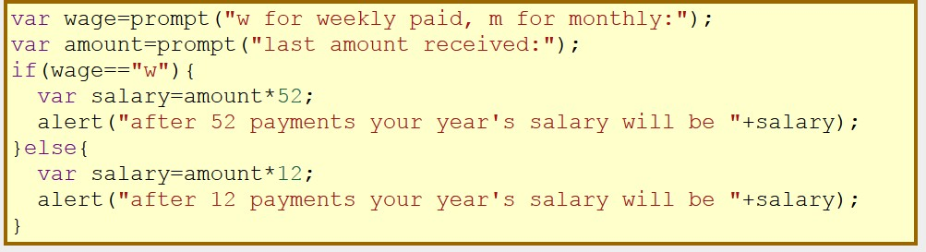
Compound Statements
if(...) {stmt1; stmt2; ...stmtn;}
if(...){...;...;} else {...;...;}
a sequence of single statements enclosed in curly braces
forms a compound statement.
2.4 - conditional with compound statements

Slide 24
Nested Conditionals
Begin Statement
if ( )
else
if ( )
else
if true - Statement
(nested) if true - Statement
Statement
End Statement

Slide 25
Nested Conditionals
Writing an if statement in another if statement is
called nesting.
• if(...)... else if(...) ...else…
• if(...){ if(...) ... } else { if(...) ... }

Slide 26
Try out: Is x positive/ negative?
var x=15;
if(x<0)
alert(" negative number");
else if(x>0)
alert(“positive number");
else
alert("it is 0 ");
alert ("end");
When x >0, is it between (0,10), or [10, 20] , or >20?

Slide 27
Try: string functions
Strings are indexed from 0!
A string of length n has characters indexed from 0
to n-1.
s.length
s.substr( start, length )
s.substring( from, upto ) // exclue the upto s.indexOf(subs), s.lastIndexOf(subs) s.indexOf(subs, from), s.lastIndexOf(subs, from) s.charAt() -> s.charAt(s.length-1) s.toUpperCase(), s.toLowerCase()
string fonctions at 3WS
2.6 - strings

Slide 28
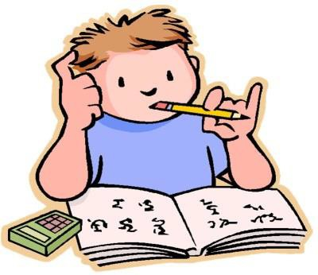
Summary
Overview
Introduction to HTML
– Tags, attributes, class/ID selector,
CSS etc.
Introduction to JS
– Input/output, variables, arithmetic operators, math object, string functions
Conditionals
• if (...) … ; else ...;
Relational operators: ==, !=, >, >=,
<, <=
Lecture
Lab
Practice !

Slide 29
Programming for the World Wide Web
Number systems
Week 1

Slide 30
Number systems
Decimal (base 10)
Ten fingers!
Binary (base 2)
Fundamental number and logical system for computer
On and Off
Hexadecimal (base 16)
Useful shorthand for large (particularly binary)
numbers, hence useful in web design...

Slide 31
Decimal
Base: 10
• Digits: 0, 1, 2, 3, 4, 5, 6, 7, 8, 9
– Each digit in a decimal number is multiplied by 10^{n-1} where n is the column number, counting from right to left
10² | 10¹ | 10⁰
2 | 9 | 3
(2 * 10²) + (9 * 10¹) + (3 * 10⁰)
= 200 + 90 + 3
= 293

Slide 32
Binary
Base: 2
Digits: 0, 1
Each bit in a binary number is multiplied by
2^{n-1} (n is the column number, counting from right
to left)
₂7 | ₂6 | ₂5 | ₂4 | ₂3 | ₂2 | ₂1 | ₂0
128 | 64 | 32 | 16 | 8 | 4 | 2 | 1
0 | 0 | 1 | 0 | 1 | 0 | 0 | 0
(1*2⁵)+(1*2³)
= 1x32+ 1x8 = 40

Slide 33
Binary
A binary number is simply a combination of bits, and bits are normally combined in groups of 8 (a byte), 16 (a word), 32 (a D-Word) and 64 (a Q-word).
#bits | Largest number
8 bits | ₂8 | 255
16 bits | ₂16 | 65535
32 bits | ₂32 | 4294967295
64 bits | ₂64 | 18446744073709551615

Slide 34
Binary
When many bytes are combined, prefixes are added. Thus, rather than saying that you have a file of size 1024 bytes, you can say you have a file of size 1 Kb.
Name | Abbreviation | Size
Kilobyte | Kb | 1024 | (2¹⁰)
Megabyte | Mb | 1048576 | (2²⁰)
Gigabyte | Gb | 1073741824 | (2³⁰)
Terabyte | Tb | 1099511627776 | (2⁴⁰)

Slide 35
Hexadecimal
Base: 16 (→ digits from decimal 0 to 15)
• Digits: 0, 1, 2, 3, 4, 5, 6, 7, 8, 9, A, B, C, D, E, F
Binary numbers quickly become tedious to write. Hexadecimal gives us a shorthand way to represent them.
Hex | 0 | 1 | 2 | 3 | 4 | 5 | 6 | 7 | 8 | 9 | A | B | C | D | E | F
Dec | 0 | 1 | 2 | 3 | 4 | 5 | 6 | 7 | 8 | 9 | 10 | 11 | 12 | 13 | 14 | 15

Slide 36
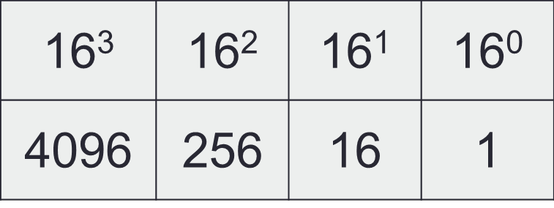
Hexadecimal
The column headings are increasing powers of 16, starting at 16⁰ on the right hand side.
A hexadecimal number:
The decimal equivalent of this number:
(2x 16² ) + (3x 16¹) + (14x 16⁰)
= 512 + 48 + 14 = 574
2 | 3 | E

Slide 37
Hexadecimal
256 (16²) | 16 (16¹) | 1 (16⁰)
8 | 4 | 2
842 (hex) = 8x256+4 x 16 + 2 x 1 = 2114 (decimal)
256 (16²) | 16 (16¹) | 1 (16⁰)
B | 2 | A
B2A (hex) = 11x 256+2 x 16 + 10 x 1 = 2858 (decimal

Slide 38
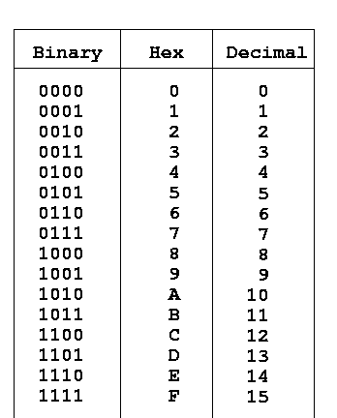
Binary & Hexadecimal

Slide 39
Binary to Hexadecimal/decimal
32 (2⁵) | 16 (2⁴) | 8 (2³) | 4 (2²) | 2 (2¹) | 1 (2⁰)
1 | 0 | 1 | 1 | 1 | 1
16 (16¹) | 1 (16⁰)
2 | F
Decimal: 2x16+15=47

Slide 40
Binary to Hexadecimal/decimal
Group each 4 binary bits from right to left to get corresponding hexadecimal number.
128 | 64 | 32 | 16 | 8 | 4 | 2 | 1
0 | 1 | 1 | 0 | 1 | 0 | 0 | 0
16 |  |  |  | 1
6 |  |  |  | 8
Binary:
Hex:
Decimal;
(6x16)+(1x8) = 104

Slide 41
Number System Conversion
http://www.tutorialspoint.com/computer_logical_or
ganization/number_system_conversion.htm
256 (2⁸) | 128 (2⁷) | 64 (2⁶) | 32 (2⁵) | 16 (2⁴) | 8 (2³) | 4 (2²) | 2 (2¹) | 1 (2⁰)
0 | 1 | 1 | 0 | 0 | 0 | 0 | 0 | 0
16 (16¹) | 1 (16⁰)
C | 0
12x16 + 0x1 =192

Slide 42
Try: number systems in JS
var hex1=0x10;
0x: prefix of hexadecimal
var oc1=010;
0: prefix of Octal (base 8, using 01234567) number
alert("oc1="+oc1+"; hex1="+hex1);

Slide 43
Decimal to Binary Conversion
Converting from decimal to binary involves repeated division by two down to zero. The remainder at each division (1 or 0) is used to construct the resultant binary number by reading the remainder bits from bottom to top
For example, to convert 60 (base ten) to binary:
60
30 | 0
15 | 0
7 | 1
3 | 1
1 | 1
0 | 1
32 | 16 | 8 | 4 | 2 | 1
1 | 1 | 1 | 1 | 0 | 0
Therefore we can say 60₁₀ = 111100₂

Slide 44
Decimal to Hexadecimal
The easiest way to convert from decimal to hexadecimal is to first convert the number to binary, and then convert each set of 4 bits to a hexadecimal value
For example, converting 60:
8 | 4 | 2 | 1
0 | 0 | 1 | 1
2+1=3=3
8 | 4 | 2 | 1
1 | 1 | 0 | 0
8+4=12=C
Therefore we can say 60₁₀ = 111100₂ = 3C₁₆

Slide 45
Reference on number system
Converting Between Binary, Octal, Decimal,
and Hexadecimal
Numeral Systems - Binary, Octal, Decimal,
Hex - RapidTables

Slide 46
alert(…): single or double quotes ?
Output:
She says: “Hello!”
alert(‘She says "Hello" '); alert(“She says: 'Hello' ");
Escape character \'quote\' alert("Say \" Hello \" ");
alert('Say \'Hello\' ');
Which way is easy, popular or powerful !
for JSON, double quote should be used.

Slide 47
Anything wrong ?
var x=2;
if(x==2)
{ alert("it is 2 " )} ;
else
alert("it is not 2");
{ alert("it is 2 " ) ;}
if(...) {stmt1; stmt2; ...stmtn;} if(...){...;...;} else {...;...;}

Slide 48
Alignment, indentation, paired brackets …
if(0) alert('a'); else{ if(0) alert('b'); else alert('c') } How to make it easy to read and check?
if(0)
alert('a');
else{
if(0)
alert('b');
else
alert('c')
}
c

Slide 49
Are they equivalent? If not, which one is correct?
var x = 4; if(x >= 0){
if(x==0) alert("x equals 0");
else alert("x is greater than 0");
}
var x = 4; if(x >= 0) if(x==0)
alert("x equals 0");
else alert("x is greater than 0");

Slide 50
Are they equivalent? If not, which one is correct?
var x = -1; if(x >= 0){
if(x==0)alert("x equals 0");
}
else alert("x is greater than 0");
x is greater than 0

